Slide 1


Vivekanand Education Society’s Institute Of Technology
Department Of Information Technology
DSA mini Project
A.Y. 2024-25
Title: Job Scheduling Using Priority Queue
Group Members:
Member1 :Vanshika Wadhwani(64)
Member2:Tisha Premchandani(50)
Mentor Name: Mrs. Kajal Jewani
Sustainability Goal:

Slide 2


Slide 3
Content
Introduction to the Project
Literature review
Problem Statement
Objectives of the Project
Scope of the Project
Requirements of the System (Hardware, Software)
Data Structure & Concepts Used
Time and Space Complexity
Implementation
Flowchart
Gantt Chart
Test Cases
Challenges and Solutions
Future Scope
Code
Output Screenshots
Conclusion
References (in IEEE Format)

Slide 4
Introduction to Project
Job Scheduling: In job scheduling, tasks are assigned to system resources (like CPU) for execution. Using a priority-based approach, jobs with higher priority (based on criteria like arrival time or urgency) are executed before lower-priority jobs to improve system efficiency.
Priority Queue: A priority queue is a data structure where elements (jobs) are dequeued based on their priority, rather than arrival order. It ensures efficient scheduling by always processing the job with the highest priority, often implemented using a heap for optimal performance.
Project Overview: The project involves building a job scheduling system using a priority queue to manage job execution. Jobs will be dynamically added, prioritized based on factors like execution time and urgency, and executed in an optimal sequence.
r Rates

Slide 5
Literature Review
Reference paper
Comparison of CPU Scheduling Algorithms: FCFS, SJF, SRTF, Round Robin, Priority Based, and Multilevel Queuing
Unifying Fixed- and Dynamic-Priority Scheduling based on Priority Promotion and an Improved Ready Queue Management Technique
Job-Shop Scheduling Model for Optimization of the Double Track Railway Scheduling
Summary
The article reviews CPU scheduling algorithms like FCFS, SJF, SRTF, RR, PB, MLQ, and MLFQ. It compares their performance using metrics such as CPU utilization, throughput, turnaround time, waiting time, and response time, highlighting the strengths and weaknesses of each algorithm through examples and discussing their real-world applications.
The paper introduces the Fixed-Priority with Priority Promotion (FPP) algorithm, combining fixed-priority and EDF scheduling for efficient task management. FPP promotes task priorities at intervals to mimic EDF, with constant-time ready queue management. FPP_Test optimizes promotion points, reducing preemptions, overhead, and scheduling complexity.
The paper presents a job-shop scheduling model for double-track railway optimization using FCFS and priority queues. Applied to the Solo-Yogyakarta network, it produces fewer delayed trains but with a higher average delay time (37.34 minutes vs. 28.69 minutes). Improvements are needed to reduce the average delay time.

Slide 6
Problem Statement
Priority Preemptive Scheduling
Simulate a Priority Preemptive Scheduling algorithm for n processes, where each process has an Arrival Time (AT), Burst Time (BT), and Priority. The process with the highest priority is executed first, and a running process can be interrupted if a higher-priority process arrives.
Requirements:
Input: Number of processes and their AT, BT, and Priority.
Scheduling: Preempt the current process if a higher-priority one arrives.
Output:
Display the Gantt Chart showing process execution.
Calculate and display Completion Time (CT), Turnaround Time (TAT), Waiting Time (WT), and Response Time (RT) for each process.
Show the average TAT, WT, and RT.
r Rates

Slide 7
Objectives of the project
Objectives :
Efficient Job Scheduling: Develop a system that prioritizes and schedules jobs based on their urgency and importance using a priority queue, ensuring optimal resource allocation and reduced wait times for high-priority tasks.
Dynamic Job Management: Enable the system to dynamically add, remove, and reorder jobs in real-time, allowing for the seamless handling of multiple tasks with varying priorities.
Simulation and Optimization: Simulate job execution and evaluate the performance of the scheduling algorithm in terms of job completion time, CPU utilization, and overall system efficiency, providing insights into the effectiveness of priority-based scheduling strategies.
r Rates

Slide 8
Scope of the project
The scope includes:
Input Handling: A function or interface to input the number of processes and their AT, BT, and Priority.
Process Scheduling: Implementing the logic for Priority Preemptive Scheduling with preemption.
Gantt Chart Generation: Displaying the process execution order visually.
Metrics Calculation: Computation of CT, TAT, WT, and RT for each process.
Average Time Calculation: Displaying the average values for TAT, WT, and RT.
Code Modularity: Design the program with modular functions to enhance readability and maintenance.

Slide 9
Requirements of the system (Hardware, software)
Hardware Requirements:
Processor: Intel i3 or higher
RAM: 4GB (8GB recommended)
Storage: 100MB for project files
Display: 1366x768 or higher
Network: Internet (optional for collaboration)
Software Requirements:
OS: Windows 10+
Programming Language: C Programming
IDE: VS Code.
Compiler: g++/gcc for C
Version Control: Git (GitHub, GitLab)
lem Statement
Problem Statement

Slide 10
Implementation
Input Process Data: Collect number of processes and their Arrival Time (AT), Burst Time (BT), and Priority.
Sort by Arrival Time: Arrange processes in order of their arrival.
Initialize Variables: Set time to 0, track completed processes, and prepare Gantt chart.
Find Highest Priority Process: At each time step, select the highest-priority process that has arrived and is not yet completed.
Execute Process: Reduce the remaining Burst Time (BT_left) of the selected process by 1 and record in Gantt chart.
Process Completion: When BT_left becomes 0, mark the process as completed and calculate its Completion Time (CT).
Calculate Metrics: After all processes are completed, calculate Turnaround Time (TAT), Waiting Time (WT), and Response Time (RT).
Display Results: Show the Gantt Chart, process metrics, and average TAT, WT, and RT.

Slide 11
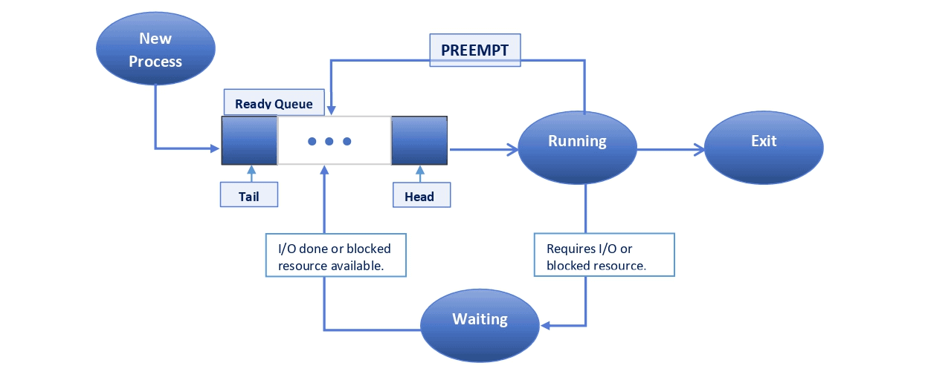
FLOWCHART
Notes:
The max flow algorithm in the visualization is :-

Slide 12
Data structure and Concepts used
In short, the key data structures and concepts used in the C program for Priority Preemptive Scheduling are:
1. Data Structures
struct process: Represents each process with fields like p_no, AT (Arrival Time), BT (Burst Time), priority, BT_left (remaining burst time), and metrics like CT (Completion Time), TAT (Turnaround Time), WT (Waiting Time), and RT (Response Time).
Gantt Chart Array: A simple array (gantt[MAX]) used to track process execution over time, including idle states (-1 for idle).
2. Concepts
Sorting by Arrival Time: Processes are sorted by arrival time to simulate realistic execution.
Preemption: The currently running process is preempted if a new process with a higher priority arrives.
Priority Queue-like Scheduling: At each time unit, the process with the highest priority is chosen for execution.
Metrics Calculation: After scheduling, metrics like Turnaround Time (TAT), Waiting Time (WT), and Response Time (RT) are computed for each process.

Slide 13
Time and Space Complexity
Time Complexity
Sorting by Arrival Time: O(n²) (due to bubble sort).
Finding Highest Priority Process: O(n * total_Burst_Time) (linear search for each time unit).
Metrics Calculation: O(n) (calculating TAT, WT, RT).
Overall Time Complexity: O(n² + n * total_Burst_Time).
Space Complexity
Process Storage: O(n) (for n processes).
Gantt Chart: O(total_Burst_Time) (for execution timeline).
Auxiliary Space for Sorting: O(1) (in-place sorting).
Overall Space Complexity: O(n + total_Burst_Time).

Slide 14
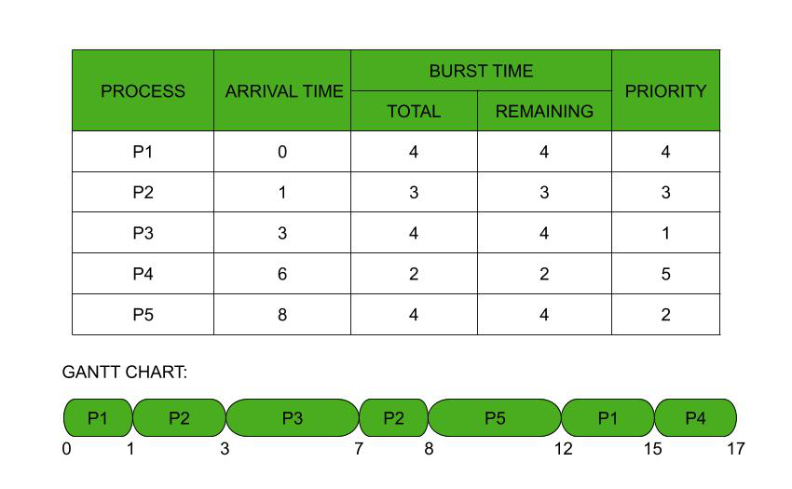
Gantt Chart

Slide 15
Future Scope
Multi-Core Support: Extend for multi-core processors to enable parallel execution.
Dynamic Priority: Implement priority adjustments based on process waiting times (aging).
Real-Time Systems: Adapt the algorithm for real-time processes with deadlines.
Graphical Interface: Develop a UI to visualize process execution and Gantt charts.
Memory and I/O Integration: Expand to consider memory and I/O-bound processes.
Algorithm Comparisons: Integrate other scheduling algorithms like Round Robin and SJF.
Context Switching: Simulate overhead and system interrupts for realistic CPU behavior.
AI-Based Scheduling: Use machine learning to optimize scheduling decisions.
Performance Metrics: Track additional metrics like CPU utilization and throughput.
Cloud and Distributed Systems: Adapt for cloud and distributed computing environments.

Slide 16
CODE:
Link to the code:
https://github.com/TV/rep31/blob/8e7299c455afa54eb89b36f0dfd6a06fd4e6b679/jobschedulingfinal.c

Slide 17
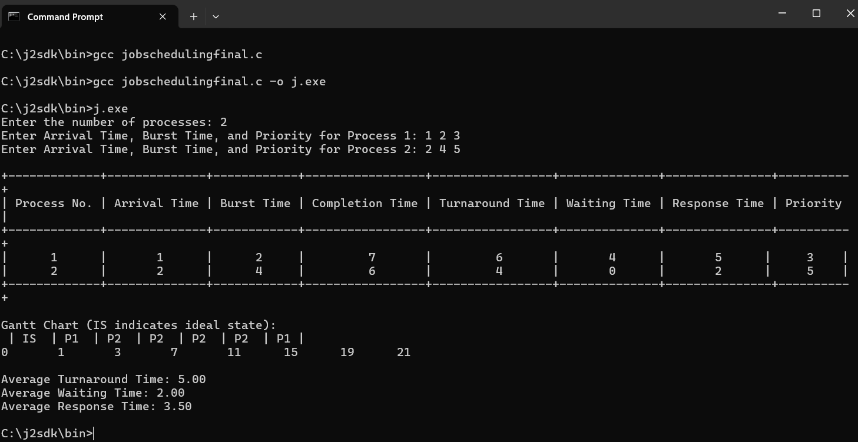
Output Screenshots

Slide 18
Test Cases
Test Case: All Processes Arrive at the Same Time
Input:
Number of processes: 4
Process 1: AT = 0, BT = 2, Priority = 2
Process 2: AT = 0, BT = 3, Priority = 1
Process 3: AT = 0, BT = 4, Priority = 3
Process 4: AT = 0, BT = 1, Priority = 4
Expected Output:
Gantt Chart: | P2 | P1 | P3 | P4 |
Completion Times: P1: 5, P2: 2, P3: 9, P4: 6
Turnaround Times: P1: 5, P2: 2, P3: 9, P4: 6
Waiting Times: P1: 3, P2: 0, P3: 5, P4: 5
Average TAT: 5.50, Average WT: 3.00

Slide 19
Challenges and Solutions
1. Handling Preemption
Challenge: Effectively managing preemption when a higher-priority process arrives. Solution: Use a BT_left variable to track remaining burst time and check for higher-priority processes at each time unit.
2. Priority Management
Challenge: Contention among processes with the same priority. Solution: Implement a tie-breaking mechanism to execute the earliest arriving process first.
3. Idle Time Management
Challenge: Accurately representing idle time in the Gantt chart. Solution: Use a placeholder (e.g., -1) for idle time and increment the time counter accordingly.
4. Calculating Metrics
Challenge: Accurate calculation of CT, TAT, WT, and RT. Solution: Update these metrics during preemption and completion, ensuring correctness.

Slide 20
Conclusion
The Job Scheduling using Priority Queue project demonstrates the effective use of data structures, particularly the priority queue, to manage task scheduling in an optimized and efficient manner. By prioritizing tasks based on urgency and execution requirements, the system ensures that critical jobs are processed first, leading to better resource allocation and reduced wait times. The implementation of dynamic job insertion and real-time scheduling simulation further highlights the practicality and relevance of priority-based scheduling in real-world systems. This project also provides a foundation for further enhancements, such as incorporating preemptive scheduling or multi-level queues, making it a valuable study in optimizing system performance.

Slide 21
References
[1] S. Palgunadi, D. Supraba and B. Harjito, "Job-Shop Scheduling model for optimization of the double track railway scheduling: (Case study: Solo-Yogyakarta railway network)," 2016 International Conference on Information & Communication Technology and Systems (ICTS), Surabaya, Indonesia, 2016, pp. 90-95, doi: 10.1109/ICTS.2016.7910279.
[2] R. M. Pathan, "Unifying fixed- and dynamic-priority scheduling based on priority promotion and an improved ready queue management technique," 21st IEEE Real-Time and Embedded Technology and Applications Symposium, Seattle, WA, USA, 2015, pp. 209-220, doi: 10.1109/RTAS.2015.7108444.
[3] S. Pemasinghe and S. Rajapaksha, "Comparison of CPU Scheduling Algorithms: FCFS, SJF, SRTF, Round Robin, Priority Based, and Multilevel Queuing," 2022 IEEE 10th Region 10 Humanitarian Technology Conference (R10-HTC), Hyderabad, India, 2022, pp. 318-323, doi: 10.1109/R10-HTC54060.2022.9929533.

